Slide 1
Chapter 7: final keyword

Slide 2
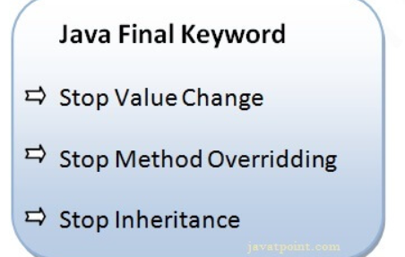
The final keyword in java is used to restrict the user
variable
method
class

Slide 3
Java final variable
If you make any variable as final, you cannot change the value of final variable(It will be constant).
class Bike9{
final int speedlimit=90;//final variable
void run(){
speedlimit=400;
}
public static void main(String args[]){
Bike9 obj=new Bike9();
obj.run();
}
}//end of class
Output:Compile Time Error

Slide 4
Java final class
If you make any class as final, you cannot extend it.
final class Bike{}
class Honda1 extends Bike{
void run(){System.out.println("running safely with 100kmph");}
public static void main(String args[]){
Honda1 honda= new Honda1();
honda.run();
}
}
Output:Compile Time Error

Slide 5
Is final method inherited?
Yes, final method is inherited but you cannot override it.
class Bike{
final void run(){System.out.println("running...");}
}
class Honda2 extends Bike{
public static void main(String args[]){
new Honda2().run();
}
}
Output:running...

Slide 6
Example of blank final variable
class Student{
int id;
String name;
final String PAN_CARD_NUMBER;
...
}
Can we initialize blank final variable?
Yes, but only in constructor
class app{
final int speedlimit;//blank final variable
app(){
speedlimit=70;
System.out.println(speedlimit);
}
public static void main(String args[]){
new app();
}
}

Slide 7
Example of static blank final variable class A
{ static final int data;//static blank final variable static data=50;
} public static void main(String args[]){
System.out.println(A.data);
}
Can we declare a constructor final?
No, because constructor is never inherited.

Slide 8
Abstract Method in Java
A method which is declared as abstract and does not have implementation is known as an abstract method.
abstract void printStatus();//no method body
Example of Abstract class that has an abstract method
abstract class Bike
{
abstract void run();
}
class Honda4 extends Bike{
void run(){System.out.println("running safely");}
public static void main(String args[]){
Bike obj = new Honda4();
obj.run();
}
}
Output:running safely

Slide 9
abstract class Shape{
abstract void draw();
}
//In real scenario, implementation is provided by others i.e. unknown by end user
class Rectangle extends Shape{
void draw(){System.out.println("drawing rectangle");}
}
class Circle1 extends Shape{
void draw(){System.out.println("drawing circle");}
}
class TestAbstraction1{
public static void main(String args[]){
Shape s=new Circle1()
s.draw();
}
}
o/p:drawing circle

Slide 10
Another example of Abstract class in java
abstract class Bank{
abstract int getRateOfInterest();
}
class SBI extends Bank{
int getRateOfInterest(){return 7;}
}
class PNB extends Bank{
int getRateOfInterest(){return 8;}
}
class TestBank{
public static void main(String args[]){
Bank b;
b=new SBI();
System.out.println("Rate of Interest is: "+b.getRateOfInterest()+" %");
b=new PNB();
System.out.println("Rate of Interest is: "+b.getRateOfInterest()+" %");
}}

Slide 11
Abstract class having constructor, data member and methods
An abstract class can have a data member, abstract method, method body (non-abstract method), constructor, and even main() method.
abstract class Bike{
Bike();
{
System.out.println("bike is created");
}
abstract void run();
void changeGear();
{
System.out.println("gear changed");
}
}
//Creating a Child class which inherits Abstract class

